Slide 1



EMOTIONAL INTELLIGENCE

Slide 2
Aristotle’s challenge:
  “Anyone can become angry – that is easy.
  But to be angry with the right person, to the
  right degree, at the right time, for the right
  purpose, and in the right way – this is not easy”
        Aristotle, the Nichomachean Ethics

Slide 3
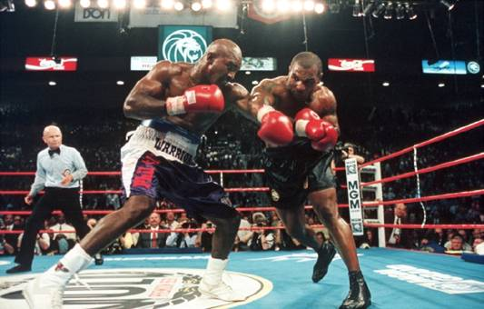
Mike Tyson’s Three-Million-Dollar Emotional Hijack

Slide 4
“We are being judged by a new yardstick:
not just how smart we are, or by our
training and expertise, but also by how well we
handle ourselves and each other”
-- Daniel Goleman,
Working With Emotional Intelligence, 1998

Slide 5
Emotional Intelligence
“ Emotional Intelligence” refers to the capacity for recognizing our own feelings and those of others, for motivating ourselves, and managing emotions well in ourselves and our relationships.

Slide 6
WHAT PROBLEMS AN INDIVIDUAL
MAY FACE WHILE HAVING LOW EI?
Students’ Responses……

Slide 7
  In today’s working environment a good level of
  technical knowledge and intellectual ability is taken
  for granted. Emotional intelligence is becoming the
  differentiator for growing and thriving.

Slide 8
Marshmallow Experiment – Stanford
Imagine you are four years old and someone makes the following proposal……..
  Marshmallows in front of you in a plate….
  If you will wait until I come, you can have two marshmallows….
  If you can’t wait until then, you can have only one, right now……

Slide 9
Marshmallow Experiment – Stanford
12 to 14 years later, those who had resisted were more……
  Self assertive, able to cope with frustrations
  Self reliant and confident, trustworthy
  Higher scores on their SAT tests

Slide 10
Goleman’s Emotional Competence Framework
Personal Competence: these competencies determine how we manage ourselves
Self-Awareness
Self-Management
Social Competence: these competencies determine how we handle relationships
Social Awareness
Relationship Management

Slide 11
The Conceptual framework
Self-Awareness: cluster concerns knowing one's internal states, preferences, resources, and intuitions.
Self-Management: cluster refers to managing ones' internal states, impulses, and resources.
Social Awareness: cluster refers to how people handle relationships and awareness of others’ feelings, needs, and concerns.
Relationship Management: cluster concerns the skill or adeptness at inducing desirable responses in others

Slide 12
(1) Self – Awareness:
Knowing one’s internal states, preferences, resources & intuitions
Emotional Awareness: Recognizing One’s Emotions and Their Effects
Accurate Self-assessment: Knowing One’s Inner Resources, Abilities, and Limits
Self-Confidence: A Strong Sense of One’s Self- Worth and Capabilities

Slide 13
(1) Developing Self – Awareness:
Becoming Aware of what triggers reactions in you. Do you know why? Students’ Responses…….
Know your strengths and weaknesses
Seek feedback with observations from people you feel comfortable with

Slide 14
(2) Self – Management
Managing one’s internal states, impulses and resources
.
  Emotional self-control: keeping disruptive emotions and impulses in check
  Adaptability: flexibility in handling change
  Achievement orientation: striving to meet or exceed a standard of excellence
  Positive outlook: persistence in pursuing goals despite obstacles and setbacks

Slide 15
Developing Self – Management
.
Count to ten, take deep breath.
Get involved in exercise, taking time out to relax, yoga, meditation.
Better planning
Get curious, not furious- Watch what you say especially when frustrated or annoyed. Reframe negative emotions into curiosity - " ... this makes absolutely no sense to me" can be replaced with, "Do you see something in this that I must be missing”

Slide 16
Developing Self Management (Contd.)
Set Clear Goals
Take feedback from others
Find ways to be more Committed
List positives in a worrisome situation
What may be the Impact of Low Self Management on an Individual??? Students’ Responses………..

Slide 17
“If your actions inspire others to dream more, learn more, do more and become more, you are a leader.”
John Quincy Adams (1767-1848)
sixth President of the United States

Slide 18
(3) Social Awareness
Awareness of others’ feelings, needs and concerns
    Empathy: sensing others' feelings and perspectives, and taking an active interest in their concerns
    Organizational Awareness: reading a group’s emotional currents and power relationships

Slide 19
Developing Social Awareness
Think about your interactions with others
Listen more, Speak less
Asking questions
Giving Feedback to others
Pay attention to body language (self and other’s)

Slide 20
Developing Social Awareness
Rahul felt anxious, and became a bit stressed when he thought about all the work he needed to do. When his supervisor brought him an additional project, he felt ____. (Select the best choice.)
a) Overwhelmed
b) Depressed
c) Ashamed
d) Self Conscious
e) Jittery

Slide 21
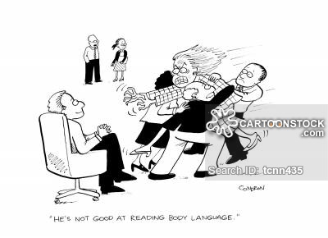
EMOTIONS????

Slide 22
(4) Relationship Management
Adeptness at inducing desirable responses in others
  Influence: having positive impact on others
  Inspirational leadership: inspiring and guiding individuals and groups
  Coach and mentor: taking an active interest in others’ development needs and bolstering their abilities
  Conflict management: negotiating and resolving conflict
  Teamwork: working with others toward a shared goal

Slide 23
Developing Relationship Management
Demonstrating Empathy
Try to know others expectations
Elicit pride in others – Reason for working together
Talk to others about their aspirations, and strengths
Bringing others into positive state by being social with them, discussing purpose, and their hopes
Which option from the above list appeals you more and Why???
Students’ Responses

Slide 24
Developing Relationship Management
Remember that emotions are contagious –
A dominant person's emotions (negative or positive) always influences others. Leaders should be careful to show only those emotions, which they want to see in others

Slide 25
Measuring Your Emotional Intelligence
Check Yourself on Various Competencies
Take Others feedback on these Competencies
Take some Standardized EI Tests

Slide 26
Measuring Your Emotional Intelligence through Self and Others’ Feedback
Rate yourself on the following item on a 0-10 scale:
I listen attentively to understand others.
0----1----2----3----4----5----6----7----8----9----10
0-Strongly Disagree
10-Strongly Agree
Request 3-6 persons (who know you well) to rate you honestly..Average their responses
Now see the difference between Your and Others Average Rating
If difference is high, it means you need to improve on this….
Do this for other competencies as well….

Slide 27
Some Tips Students can use to control their emotions
Take 30 deep belly-breaths
Get good knowledge about EI
Redirect your mind to think something different
Eat your meals
Ask yourself: is this useful?
Observe the feeling
Stay in the present
Find good ways to relax

Slide 28
Strategies Promoting for Emotional Intelligence
Taking the time for mindfulness
Recognizing and naming emotions
Understanding the causes of feelings
Differentiating between emotion and the need to take action
Preventing depression through “learned optimism”
Managing anger through learned behavior or distraction techniques
Listening for the lessons of feelings
Using “gut feelings” in decision making
Developing listening skills
Notes:
In “differentiating between emotion and the need to take action” add two subcomponents:
promoting action in response to sadness/depress
inhibiting action in response to anger/hostility
“Gut feelings” are somatic markers. A neurobiological understanding of how unconscious and conscious use of “gut feelings” can effectively guide decisions. Could this be the essence of wisdom?

Slide 29
“Any decision to shift your set point on any of these emotional intelligence competencies should be based on thoughtful introspection about whether it is keeping you from being the person you wish to be and living the life you aspire to.
This, of course, requires Awareness, something that, when it comes to understanding how we respond to emotional challenges, is in short supply.”
Richard j. Davidson

Slide 30
Focus on breath (Normal Breathe In- Breathe Out) each day for a few minutes, seems the easiest and best way to enhance Emotional Intelligence!!!
Lets practice for 1-2 minutes….

